Slide 1
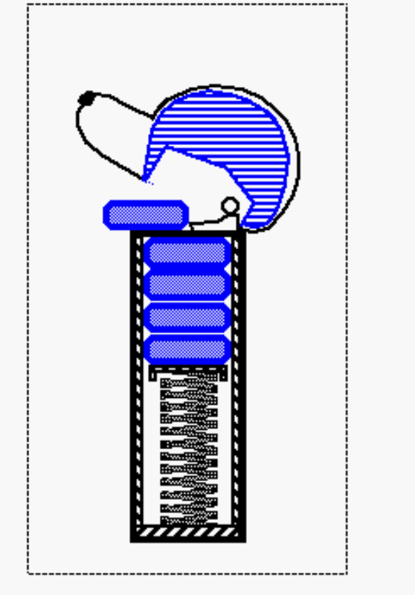
Basic Data Structures
Review of CPSC 201 plus some new material

Slide 2
Stacks

Slide 3
Abstract Data Types (ADTs)
An abstract data type (ADT) is an abstraction of a data structure
An ADT specifies:
  Data stored
  Operations on the data
  Error conditions associated with operations
Example: ADT modeling a simple stock trading system
  The data stored are buy/sell orders
  The operations supported are
    order buy(stock, shares, price)
    order sell(stock, shares, price)
    void cancel(order)
  Error conditions:
    Buy/sell a nonexistent stock
    Cancel a nonexistent order

Slide 4
The Stack ADT
The Stack ADT stores arbitrary objects
Insertions and deletions follow the last-in first-out scheme
Think of a spring-loaded plate dispenser
Main stack operations:
  push(object): inserts an element
  object pop(): removes and returns the last inserted element
Auxiliary stack operations:
  object top(): returns the last inserted element without removing it
  integer size(): returns the number of elements stored
  boolean isEmpty(): indicates whether no elements are stored

Slide 5
Exceptions
Attempting the execution of an operation of ADT may sometimes cause an error condition, called an exception
Exceptions are said to be “thrown” by an operation that cannot be executed
In the Stack ADT, operations pop and top cannot be performed if the stack is empty
Attempting the execution of pop or top on an empty stack throws an EmptyStackException

Slide 6
Applications of Stacks
Direct applications
  Page-visited history in a Web browser
  Undo sequence in a text editor
  Chain of method calls in the Java Virtual Machine
Indirect applications
  Auxiliary data structure for algorithms
  Component of other data structures

Slide 7
Method Stack in the JVM
main() {
int i = 5;
foo(i);
}
foo(int j) {
int k;
k = j+1;
bar(k);
}
bar(int m) {
…
}
The Java Virtual Machine (JVM) keeps track of the chain of active methods with a stack
When a method is called, the JVM pushes on the stack a frame containing
  Local variables and return value
  Program counter, keeping track of the statement being executed
When a method ends, its frame is popped from the stack and control is passed to the method on top of the stack
bar
PC = 1
m = 6
foo
PC = 3
j = 5
k = 6
main
PC = 2
i = 5

Slide 8
Array-based Stack
A simple way of implementing the Stack ADT uses an array
We add elements from left to right
A variable keeps track of the index of the top element
Algorithm size()
return t + 1
Algorithm pop()
if isEmpty() then
throw EmptyStackException
else
t ← t − 1
return S[t + 1]
…
S
0
1
2
t

Slide 9

Array-based Stack (cont.)
The array storing the stack elements may become full
A push operation will then throw a FullStackException
  Limitation of the array-based implementation
  Not intrinsic to the Stack ADT
Algorithm push(o)
if t = S.length − 1 then
throw FullStackException
else
t ← t + 1
S[t] ← o
…
S
0
1
2
t

Slide 10
Performance and Limitations
Performance
  Let n be the number of elements in the stack
  The space used is O(n)
  Each operation runs in time O(1)
Limitations
  The maximum size of the stack must be defined a priori and cannot be changed
  Trying to push a new element into a full stack causes an implementation-specific exception

Slide 11
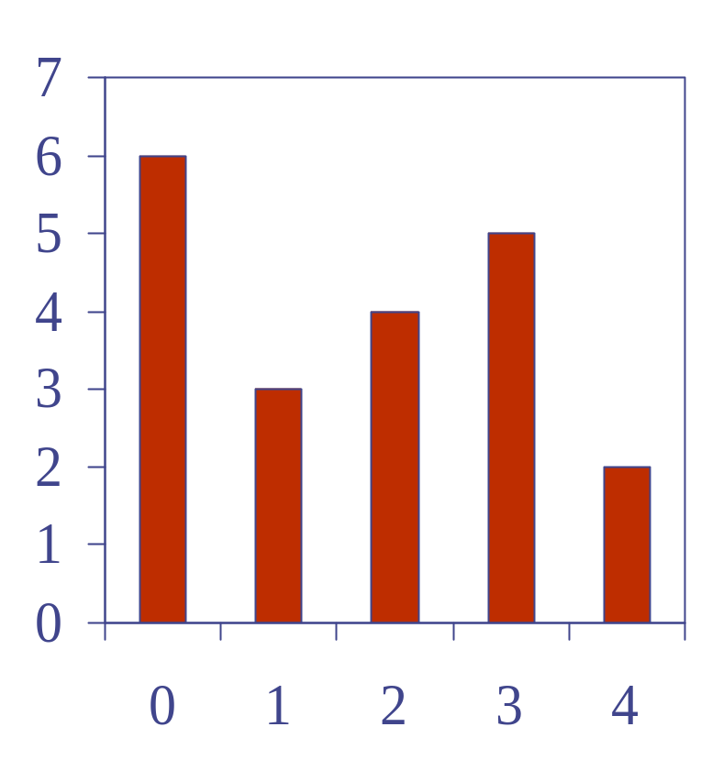
Computing Spans
We show how to use a stack as an auxiliary data structure in an algorithm
Given an an array X, the span S[i] of X[i] is the maximum number of consecutive elements X[j] immediately preceding X[i] and such that X[j] ≤ X[i]
Spans have applications to financial analysis
  E.g., stock at 52-week high
X
6 | 3 | 4 | 5 | 2
1 | 1 | 2 | 3 | 1
S

Slide 12
Quadratic Algorithm
Algorithm spans1(X, n)
Input array X of n integers
Output array S of spans of X #
S ← new array of n integers n
for i ← 0 to n − 1 do n
s ← 1 n
while s ≤ i ∧ X[i − s] ≤ X[i] 1 + 2 + …+ (n − 1)
s ← s + 1 1 + 2 + …+ (n − 1)
S[i] ← s n
return S 1
boolean and
Algorithm spans1 runs in O(n²) time. Remember, this is a worst case analysis.

Slide 13
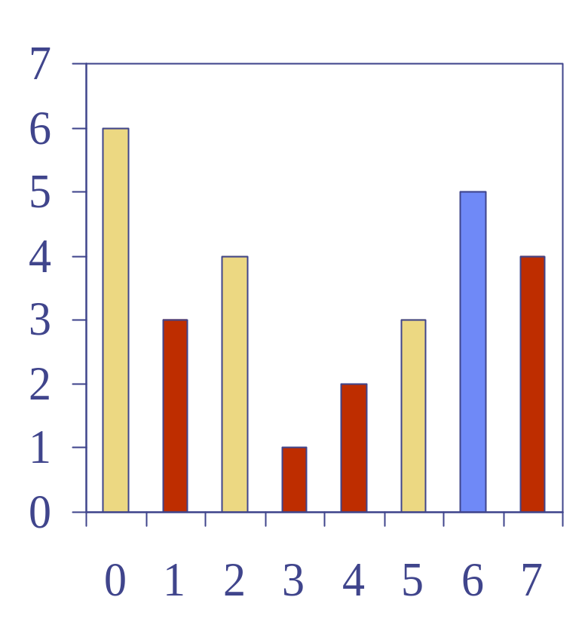
Computing Spans with a Stack
We keep in a stack the indices of the elements visible when “looking back”
We scan the array from left to right
  Let i be the current index
  We pop indices from the stack until we find index j such that X[i] < X[j]
  We set S[i] ← i − j
  We push i onto the stack

Slide 14
Linear Algorithm
Each index of the array
  Is pushed into the stack exactly once
  Is popped from the stack at most once
The statements in the while-loop are executed at most n times
Algorithm spans2 runs in O(n) time
Algorithm spans2(X, n) #
S ← new array of n integers n
A ← new empty stack 1
for i ← 0 to n − 1 do n
while (¬A.isEmpty() ∧
X[top()] ≤ X[i] ) do n
j ← A.pop() n
if A.isEmpty() then n
S[i] ← i + 1 n
else
S[i] ← i − j n
A.push(i) n
return S 1

Slide 15
Trace this algorithm
for i ← 0 to n − 1 do
while (¬A.isEmpty() ∧
X[top()] ≤ X[i] ) do j ← A.pop() if A.isEmpty() then S[i] ← i + 1 else
S[i] ← i − j A.push(i)
return S
i=0, S[0] =1
stack: 0
i=1, X[0]≤X[1] is F
So, j is not initialized
and S[i]=1-j is undefined.
X | 6 | 3 | 4 | 5 | 2
S | 1 | 1 | 2 | 3 | 1
index | 0 | 1 | 2 | 3 | 4

Slide 16
Linear Algorithm
boolean not
Each index of the array
  Is pushed into the stack exactly once
  Is popped from the stack at most once
The statements in the while-loop are executed at most n times
Algorithm spans2 runs in O(n) time
Algorithm spans2(X, n) #
S ← new array of n integers n
A ← new empty stack 1
for i ← 0 to n − 1 do n
while (¬A.isEmpty() ∧
X[A.top()] ≤ X[i] ) do n
j ← A.pop() n
if A.isEmpty() then n
S[i] ← i + 1 n
else
S[i] ← i − j n
S[i] ← i − A.top() n
A.push(i) n
return S 1

Slide 17
Trace the corrected version
for i ← 0 to n − 1 do while (¬A.isEmpty() ∧
X[A.top()] ≤ X[i] ) do j ← A.pop() if A.isEmpty() then S[i] ← i + 1 else
S[i] ← i − A.top()
A.push(i)
return S
i=0, S[0]=1
stack: 0
i=1, X[0]≤X[1] is F
S[1]=1-0=1
stack: 0 1
i=2, X[1]≤X[2] isT
stack: 0
X[0]≤X[2] is F
S[2] =2-0 =2
stack: 0 2
X | 6 | 3 | 4 | 5 | 2
S | 1 | 1 | 2 | 3 | 1
index | 0 | 1 | 2 | 3 | 4

Slide 18
Trace the corrected version- continued
for i ← 0 to n − 1 do while (¬A.isEmpty() ∧
X[A.top()] ≤ X[i] ) do j ← A.pop() if A.isEmpty() then S[i] ← i + 1 else
S[i] ← i − A.top()
A.push(i)
return S
i=3, X[2] ≤ X[3] is T
stack: 0
X[0] ≤ X[3] is F
S[3] = 3 - 0 = 3
stack: 0 3
i=4, X[3] ≤ X[4] is F
S[4] = 4 - 3 = 1
stack: 0 3 4
So, this seems to work.
X | 6 | 3 | 4 | 5 | 2
S | 1 | 1 | 2 | 3 | 1
index | 0 | 1 | 2 | 3 | 4

Slide 19
Growable Array-based Stack
In a push operation, when the array is full, instead of throwing an exception, we can replace the array with a larger one
How large should the new array be?
  incremental strategy: increase the size by a constant c
  doubling strategy: double the size
Algorithm push(o)
if t = S.length − 1 then
A ← new array of
size …
for i ← 0 to t do
A[i] ← S[i]
S ← A
t ← t + 1
S[t] ← o

Slide 20
Comparison of the Strategies
We compare the incremental strategy and the doubling strategy by analyzing the total time T(n) needed to perform a series of n push operations
We assume that we start with an empty stack represented by an array of size 1
We will call the amortized time of a push operation the average time taken by a push over the series of operations, i.e., T(n)/n

Slide 21
Amortized Running Time
There are two ways to calculate this -
  1) use a financial model - called the accounting method or
  2) use an energy method - called the potential function model.
We'll use the accounting method.
The accounting method determines the amortized running time with a system of credits and debits
We view a computer as a coin-operated device requiring
  1 cyber-dollar for a constant amount of computing.

Slide 22
Amortization as a Tool
Amortization is used to analyze the running times of algorithms with widely varying performance.
The term comes from accounting.
It is useful as it gives us a way of to do average-case analysis without using any probability.
Definition: The amortized running time of an operation that is defined by a series of operations is given by the worst-case total running time of the series of operations divided by the number of operations.

Slide 23
Accounting Method
  We set up a scheme for charging operations. This is known as an amortization scheme.
  The scheme must give us always enough money to pay for the actual cost of the operation.
  The total cost of the series of operations is no more than the total amount charged.
  (amortized time) ≤ (total $ charged) / (# operations)

Slide 24
Analysis of the Incremental Strategy
We replace the array k = n/c times and extend it by a constant number, c , of added array elements.
The total time T(n) of a series of n push operations is proportional to
n + c + 2c + 3c + 4c + … + kc =
n + c(1 + 2 + 3 + … + k) =
n + ck(k + 1)/2
Since c is a constant, T(n) is O(n + k²), i.e.,
O(n²) = O(n²) + (n/c)² = O(n²)
The amortized time of a push operation is O(n)

Slide 25
Doubling Strategy Analysis
We replace the array k = log₂ n times
The total time T(n) of a series of n push operations is proportional to
n + 1 + 2 + 4 + 8 + …+ 2^{k} =
n + (1-2^{k+1})/(1-2) see pg 687-8
n + 2^{k + 1} −1 = 2n −1
T(n) is O(n)
The amortized time of a push operation is O(1)
geometric series
2
4
1
1
8

Slide 26
Amortization Scheme for the Doubling Strategy
Consider again the k phases, where each phase consisting of twice as many pushes as the one before.
At the end of a phase we must have saved enough to pay for the array-growing push of the next phase.
At the end of phase i, we want to have saved i cyber-dollars, to pay for the array growth for the beginning of the next phase.

Slide 27
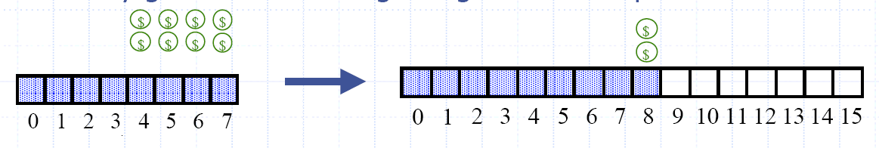
The Argument
We charge $3 for a push.
The $2 saved for a regular push are “stored” in the second half of the array.
Thus, we will have 2(i/2)=i cyber-dollars saved at then end of phase i.
• Therefore, each push runs in O(1) amortized time; n pushes run in O(n) time.

Slide 28
Stack Interface in Java
public interface Stack {
public int size();
public boolean isEmpty();
public Object top()
throws EmptyStackException;
public void push(Object o);
public Object pop()
throws EmptyStackException;
}
Java interface corresponding to our Stack ADT
Requires the definition of class EmptyStackException
Different from the built-in Java class java.util.Stack

Slide 29
Array-based Stack in Java
public class ArrayStack
implements Stack {
// holds the stack elements
private Object S[ ];
// index to top element
private int top = -1;
// constructor
public ArrayStack(int capacity) {
S = new Object[capacity]);
}
public Object pop()
throws EmptyStackException {
if isEmpty()
throw new EmptyStackException
(“Empty stack: cannot pop”);
Object temp = S[top];
// facilitates garbage collection
S[top] = null;
top = top – 1;
return temp;
}

Slide 30
Queues

Slide 31
Outline and Reading
The Queue ADT (§2.1.2)
Implementation with a circular array (§2.1.2)
Growable array-based queue
Queue interface in Java

Slide 32
The Queue ADT
The Queue ADT stores arbitrary objects
Insertions and deletions follow the first-in first-out scheme
Insertions are at the rear of the queue and removals are at the front of the queue
Main queue operations:
  enqueue(object): inserts an element at the end of the queue
  object dequeue(): removes and returns the element at the front of the queue
Auxiliary queue operations:
  object front(): returns the element at the front without removing it
  integer size(): returns the number of elements stored
  boolean isEmpty(): indicates whether no elements are stored
Exceptions
  Attempting the execution of dequeue or front on an empty queue throws an EmptyQueueException

Slide 33
Applications of Queues
Direct applications
  Waiting lists, bureaucracy
  Access to shared resources (e.g., printer)
  Multiprogramming
Indirect applications
  Auxiliary data structure for algorithms
  Component of other data structures

Slide 34
Array-based Queue
Use an array of size N in a circular fashion
Two variables keep track of the front and rear
  f index of the front element
  r index immediately past the rear element
Array location r is kept empty
normal configuration
Q
0
1
2
f
r
wrapped-around configuration
Q
0
1
2
r
f

Slide 35
Queue Operations
We use the modulo operator (remainder of division)
Algorithm size()
return (N − f + r) mod N
Algorithm isEmpty()
return (f = r)
Q
0
1
2
f
r
Q
0
1
2
r
f

Slide 36
Queue Operations (cont.)
Operation enqueue throws an exception if the array is full
This exception is implementation-dependent
Algorithm enqueue(o)
if size() = N − 1 then
throw FullQueueException
else
Q[r] ← o
r ← (r + 1) mod N
Q
0
1
2
f
r
Q
0
1
2
r
f

Slide 37
Queue Operations (cont.)
Operation dequeue throws an exception if the queue is empty
This exception is specified in the queue ADT
Algorithm dequeue()
if isEmpty() then
throw EmptyQueueException
else
o ← Q[f]
f ← (f + 1) mod N
return o
Q
0
1
2
f
r
Q
0
1
2
r
f

Slide 38
Growable Array-based Queue
In an enqueue operation, when the array is full, instead of throwing an exception, we can replace the array with a larger one
Similar to what we did for an array-based stack
The enqueue operation has amortized running time
  O(n) with the incremental strategy
  O(1) with the doubling strategy

Slide 39
Queue Interface in Java
public interface Queue {
public int size();
public boolean isEmpty();
public Object front()
throws EmptyQueueException;
public void enqueue(Object o);
public Object dequeue()
throws EmptyQueueException;
}
Java interface corresponding to our Queue ADT
Requires the definition of class EmptyQueueException
No corresponding built-in Java class

Slide 40
Vectors

Slide 41
Outline and Reading
The Vector ADT (§2.2.1)
Array-based implementation (§2.2.1)

Slide 42
The Vector ADT
The Vector ADT extends the notion of array by storing a sequence of arbitrary objects
An element can be accessed, inserted or removed by specifying its rank (number of elements preceding it)
An exception is thrown if an incorrect rank is specified (e.g., a negative rank)
Main vector operations:
  object elemAtRank(integer r): returns the element at rank r without removing it
  object replaceAtRank(integer r, object o): replace the element at rank with o and return the old element
  insertAtRank(integer r, object o): insert a new element o to have rank r
  object removeAtRank(integer r): removes and returns the element at rank r
Additional operations size() and isEmpty()

Slide 43
Applications of Vectors
Direct applications
  Sorted collection of objects (elementary database)
Indirect applications
  Auxiliary data structure for algorithms
  Component of other data structures

Slide 44
Array-based Vector
Use an array V of size N
A variable n keeps track of the size of the vector (number of elements stored)
Operation elemAtRank(r) is implemented in O(1) time by returning V[r]
V
0
1
2
r
n

Slide 45
Insertion
In operation insertAtRank(r, o), we need to make room for the new element by shifting forward the n − r elements V[r], …, V[n − 1]
In the worst case (r = 0), this takes O(n) time
V
0
1
2
r
n
V
0
1
2
r
n
V
o
0
1
2
r
n

Slide 46
Deletion
In operation removeAtRank(r), we need to fill the hole left by the removed element by shifting backward the n − r − 1 elements V[r + 1], …, V[n − 1]
In the worst case (r = 0), this takes O(n) time
V
o
0
1
2
r
n
V
0
1
2
r
n
V
0
1
2
r
n

Slide 47
Performance
In the array based implementation of a Vector
  The space used by the data structure is O(n)
  size, isEmpty, elemAtRank and replaceAtRank run in O(1) time
  insertAtRank and removeAtRank run in O(n) time
If we use the array in a circular fashion, insertAtRank(0) and removeAtRank(0) run in O(1) time
In an insertAtRank operation, when the array is full, instead of throwing an exception, we can replace the array with a larger one

Slide 48




Lists and Sequences

Slide 49
Outline and Reading
Singly linked list
Position ADT and List ADT (§2.2.2)
Doubly linked list (§ 2.2.2)
Sequence ADT (§ 2.2.3)
Implementations of the sequence ADT (§ 2.2.3)
Iterators (2.2.3)

Slide 50
Singly Linked List
A singly linked list is a concrete data structure consisting of a sequence of nodes
Each node stores
  element
  link to the next node
next
elem
node
∅
A
B
C
D

Slide 51
Stack with a Singly Linked List
We can implement a stack with a singly linked list
The top element is stored at the first node of the list
The space used is O(n) and each operation of the Stack ADT takes O(1) time
nodes
t
∅
elements

Slide 52
Queue with a Singly Linked List
We can implement a queue with a singly linked list
  The front element is stored at the first node
  The rear element is stored at the last node
The space used is O(n) and each operation of the Queue ADT takes O(1) time
r
nodes
f
∅
elements

Slide 53
Position ADT
The Position ADT models the notion of the place within a data structure where a single object is stored
It gives a unified view of diverse ways of storing data, such as
  a cell of an array
  a node of a linked list
Just one method:
  object element(): returns the element stored at the position

Slide 54
List ADT
The List ADT models a sequence of positions storing arbitrary objects
It establishes a before/after relation between positions
Generic methods:
  size(), isEmpty()
Query methods:
  isFirst(p), isLast(p)
Accessor methods:
  first(), last()
  before(p), after(p)
Update methods:
  replaceElement(p, o), swapElements(p, q)
  insertBefore(p, o), insertAfter(p, o),
  insertFirst(o), insertLast(o)
  remove(p)

Slide 55
Doubly Linked List
A doubly linked list provides a natural implementation of the List ADT
Nodes implement Position and store:
  element
  link to the previous node
  link to the next node
Special trailer and header nodes
prev
next
elem
node
header
nodes/positions
trailer
elements

Slide 56
Insertion
We visualize operation insertAfter(p, X), which returns position q
p
A
B
C
p
A
B
q
C
X
p
q
A
B
X
C

Slide 57
Deletion
We visualize remove(p), where p = last()
p
A
B
C
D
A
B
C
p
D
A
B
C

Slide 58
Performance
In the implementation of the List ADT by means of a doubly linked list
  The space used by a list with n elements is O(n)
  The space used by each position of the list is O(1)
  All the operations of the List ADT run in O(1) time
  Operation element() of the
  Position ADT runs in O(1) time

Slide 59
Sequence ADT
The Sequence ADT is the union of the Vector and List ADTs
Elements accessed by
  Rank, or
  Position
Generic methods:
  size(), isEmpty()
Vector-based methods:
  elemAtRank(r), replaceAtRank(r, o), insertAtRank(r, o), removeAtRank(r)
List-based methods:
  first(), last(), before(p), after(p), replaceElement(p, o), swapElements(p, q), insertBefore(p, o), insertAfter(p, o), insertFirst(o), insertLast(o), remove(p)
Bridge methods:
  atRank(r), rankOf(p)

Slide 60
Applications of Sequences
The Sequence ADT is a basic, general-purpose, data structure for storing an ordered collection of elements
Direct applications:
  Generic replacement for stack, queue, vector, or list
  small database (e.g., address book)
Indirect applications:
  Building block of more complex data structures

Slide 61
Array-based Implementation
We use a circular array storing positions
A position object stores:
  Element
  Rank
Indices f and l keep track of first and last positions
elements
0
1
2
3
positions
S
f
l

Slide 62
Sequence Implementations
Operation | Array | List
size, isEmpty | 1 | 1
atRank, rankOf, elemAtRank | 1 | n
first, last, before, after | 1 | 1
replaceElement, swapElements | 1 | 1
replaceAtRank | 1 | n
insertAtRank, removeAtRank | n | n
insertFirst, insertLast | 1 | 1
insertAfter, insertBefore | n | 1
remove | n | 1

Slide 63
Iterators
An iterator abstracts the process of scanning through a collection of elements
Methods of the ObjectIterator ADT:
  object object()
  boolean hasNext()
  object nextObject()
  reset()
Extends the concept of Position by adding a traversal capability
Implementation with an array or singly linked list
An iterator is typically associated with an another data structure
We can augment the Stack, Queue, Vector, List and Sequence ADTs with method:
  ObjectIterator elements()
Two notions of iterator:
  snapshot: freezes the contents of the data structure at a given time
  dynamic: follows changes to the data structure

Slide 64
Trees
Make Money Fast!
Stock
Fraud
Ponzi
Scheme
Bank
Robbery

Slide 65
Outline and Reading
Tree ADT (§2.3.1)
Preorder and postorder traversals (§2.3.2)
BinaryTree ADT (§2.3.3)
Inorder traversal (§2.3.3)
Euler Tour traversal (§2.3.3)
Template method pattern
Data structures for trees (§2.3.4)
Java implementation (http://jdsl.org)

Slide 66
What is a Tree
In computer science, a tree is an abstract model of a hierarchical structure
A tree consists of nodes with a parent-child relation
Applications:
  Organization charts
  File systems
  Programming environments
Computers”R”Us
Sales
Manufacturing
R&D
US
International
Laptops
Desktops
Europe
Asia
Canada

Slide 67
Tree Terminology
Root: node without parent (A)
Internal node: node with at least one child (A, B, C, F)
External node (a.k.a. leaf ): node without children (E, I, J, K, G, H, D)
Ancestors of a node: parent, grandparent, grand-grandparent, etc.
Depth of a node: number of ancestors
Height of a tree: maximum depth of any node (3)
Descendant of a node: child, grandchild, grand-grandchild, etc.
Subtree: tree consisting of a node and its descendants
A
subtree
B
C
D
E
F
G
H
I
J
K

Slide 68
Tree ADT
We use positions to abstract nodes
Generic methods:
  integer size()
  boolean isEmpty()
  objectIterator elements()
  positionIterator positions()
Accessor methods:
  position root()
  position parent(p)
  positionIterator children(p)
Query methods:
  boolean isInternal(p)
  boolean isExternal(p)
  boolean isRoot(p)
Update methods:
  swapElements(p, q)
  object replaceElement(p, o)
Additional update methods may be defined by data structures implementing the Tree ADT

Slide 69
Preorder Traversal
A traversal visits the nodes of a tree in a systematic manner
In a preorder traversal, a node is visited before its descendants
Application: print a structured document
Algorithm preOrder(v)
  visit(v)
  for each child w of v
  preorder (w)
1
Make Money Fast!
2
5
9
1. Motivations
2. Methods
References
3
4
6
7
8
1.1 Greed
1.2 Avidity
2.1 Stock
Fraud
2.2 Ponzi
Scheme
2.3 Bank
Robbery

Slide 70
Postorder Traversal
In a postorder traversal, a node is visited after its descendants
Application: compute space used by files in a directory and its subdirectories
Algorithm postOrder(v)
  for each child w of v
  postOrder (w)
  visit(v)
9
cs16/
8
3
7
homeworks/
programs/
todo.txt
1K
1
2
4
5
6
h1c.doc
3K
h1nc.doc
2K
DDR.java
10K
Stocks.java
25K
Robot.java
20K

Slide 71
Binary Tree
A binary tree is a tree with the following properties:
  Each internal node has two children
  The children of a node are an ordered pair
We call the children of an internal node left child and right child
Alternative recursive definition: a binary tree is either
  a tree consisting of a single node, or
  a tree whose root has an ordered pair of children, each of which is a binary tree
Applications:
  arithmetic expressions
  decision processes
  searching
A
B
C
D
E
F
G
H
I

Slide 72
Arithmetic Expression Tree
Binary tree associated with an arithmetic expression
  internal nodes: operators
  external nodes: operands
Example: arithmetic expression tree for the expression (2 × (a − 1) + (3 × b))
+
×
×
2
−
3
b
a
1

Slide 73
Decision Tree
Binary tree associated with a decision process
  internal nodes: questions with yes/no answer
  external nodes: decisions
Example: dining decision
Want a fast meal?
Yes
No
How about coffee?
On expense account?
Yes
No
Yes
No
Starbucks
Spike’s
Al Forno
Café Paragon

Slide 74
Properties of Binary Trees
Notation
  n number of nodes
  e number of external nodes
  i number of internal nodes
  h height
Properties:
  e = i + 1
  n = 2e − 1
  h ≤ i
  h ≤ (n − 1)/2
  e ≤ 2^{h}
  h ≥ log₂ e
  h ≥ log₂ (n + 1) − 1

Slide 75
BinaryTree ADT
The BinaryTree ADT extends the Tree ADT, i.e., it inherits all the methods of the Tree ADT
Additional methods:
  position leftChild(p)
  position rightChild(p)
  position sibling(p)
Update methods may be defined by data structures implementing the BinaryTree ADT

Slide 76
Inorder Traversal
In an inorder traversal a node is visited after its left subtree and before its right subtree
Application: draw a binary tree
  x(v) = inorder rank of v
  y(v) = depth of v
Algorithm inOrder(v)
  if isInternal (v)
    inOrder (leftChild (v))
  visit(v)
  if isInternal (v)
    inOrder (rightChild (v))
6
2
8
1
4
7
9
3
5

Slide 77
Print Arithmetic Expressions
Specialization of an inorder traversal
  print operand or operator when visiting node
  print “(“ before traversing left subtree
  print “)“ after traversing right subtree
Algorithm printExpression(v)
  if isInternal (v)
  print(“(’’)
    inOrder (leftChild (v))
  print(v.element ())
  if isInternal (v)
    inOrder (rightChild (v))
  print (“)’’)
+
×
×
2
−
3
b
((2 × (a − 1)) + (3 × b))
a
1

Slide 78
Evaluate Arithmetic Expressions
Specialization of a postorder traversal
  recursive method returning the value of a subtree
  when visiting an internal node, combine the values of the subtrees
Algorithm evalExpr(v)
  if isExternal (v)
    return v.element ()
  else
  x ← evalExpr(leftChild (v))
  y ← evalExpr(rightChild (v))
  ◊ ← operator stored at v
    return x ◊ y
+
×
×
2
−
3
2
5
1

Slide 79
Euler Tour Traversal
Generic traversal of a binary tree
Includes a special cases the preorder, postorder and inorder traversals
Walk around the tree and visit each node three times:
  on the left (preorder)
  from below (inorder)
  on the right (postorder)
+
L
×
R
×
B
2
−
3
2
5
1

Slide 80
Template Method Pattern
Generic algorithm that can be specialized by redefining certain steps
Implemented by means of an abstract Java class
Visit methods that can be redefined by subclasses
Template method eulerTour
  Recursively called on the left and right children
  A Result object with fields leftResult, rightResult and finalResult keeps track of the output of the recursive calls to eulerTour
public abstract class EulerTour {
protected BinaryTree tree;
protected void visitExternal(Position p, Result r) { }
protected void visitLeft(Position p, Result r) { }
protected void visitBelow(Position p, Result r) { } protected void visitRight(Position p, Result r) { }
protected Object eulerTour(Position p) {
Result r = new Result();
if tree.isExternal(p) { visitExternal(p, r); }
else {
visitLeft(p, r);
r.leftResult = eulerTour(tree.leftChild(p));
visitBelow(p, r);
r.rightResult = eulerTour(tree.rightChild(p));
visitRight(p, r);
return r.finalResult;
} …

Slide 81
Specializations of EulerTour
We show how to specialize class EulerTour to evaluate an arithmetic expression
Assumptions
  External nodes store Integer objects
  Internal nodes store Operator objects supporting method
  operation (Integer, Integer)
public class EvaluateExpression
extends EulerTour {
protected void visitExternal(Position p, Result r) {
r.finalResult = (Integer) p.element();
}
protected void visitRight(Position p, Result r) {
Operator op = (Operator) p.element();
r.finalResult = op.operation(
(Integer) r.leftResult,
(Integer) r.rightResult
);
}
…
}

Slide 82
Data Structure for Trees
A node is represented by an object storing
  Element
  Parent node
  Sequence of children nodes
Node objects implement the Position ADT
∅
B
∅
∅
A
D
F
B
A
D
F
C
E
∅
∅
C
E

Slide 83
Data Structure for Binary Trees
A node is represented by an object storing
  Element
  Parent node
  Left child node
  Right child node
Node objects implement the Position ADT
∅
B
∅
∅
B
A
D
A
D
∅
∅
∅
∅
C
E
C
E

Slide 84
Java Implementation
Tree interface
BinaryTree interface extending Tree
Classes implementing Tree and BinaryTree and providing
  Constructors
  Update methods
  Print methods
Examples of updates for binary trees
  expandExternal(v)
  removeAboveExternal(w)
expandExternal(v)
v
v
A
A
∅
∅
removeAboveExternal(w)
A
B
w
B
C

Slide 85
Trees in JDSL
JDSL is the Library of Data Structures in Java
Tree interfaces in JDSL
  InspectableBinaryTree
  InspectableTree
  BinaryTree
  Tree
Inspectable versions of the interfaces do not have update methods
Tree classes in JDSL
  NodeBinaryTree
  NodeTree
JDSL was developed at Brown’s Center for Geometric Computing
See the JDSL documentation and tutorials at http://jdsl.org
InspectableTree
Tree
InspectableBinaryTree
BinaryTree

Slide 86
Priority Queues
Sell | 100 | IBM | $122
Sell | 300 | IBM | $120
Buy | 500 | IBM | $119
Buy | 400 | IBM | $118

Slide 87
Outline and Reading
PriorityQueue ADT (§2.4.1)
Total order relation (§2.4.1)
Comparator ADT (§2.4.1)
Sorting with a priority queue (§2.4.2)
Selection-sort (§2.4.2)
Insertion-sort (§2.4.2)

Slide 88
Priority Queue ADT
A priority queue stores a collection of items
An item is a pair
(key, element)
Main methods of the Priority Queue ADT
  insertItem(k, o)
  inserts an item with key k and element o
  removeMin()
  removes the item with smallest key and returns its element
Additional methods
  minKey(k, o)
  returns, but does not remove, the smallest key of an item
  minElement()
  returns, but does not remove, the element of an item with smallest key
  size(), isEmpty()
Applications:
  Standby flyers
  Auctions
  Stock market

Slide 89
Total Order Relation
Keys in a priority queue can be arbitrary objects on which an order is defined
Two distinct items in a priority queue can have the same key
Mathematical concept of total order relation ≤
  Reflexive property:
  x ≤ x
  Antisymmetric property:
  x ≤ y ∧ y ≤ x ⇒ x = y
  Transitive property:
  x ≤ y ∧ y ≤ z ⇒ x ≤ z

Slide 90
Comparator ADT
A comparator encapsulates the action of comparing two objects according to a given total order relation
A generic priority queue uses an auxiliary comparator
The comparator is external to the keys being compared
When the priority queue needs to compare two keys, it uses its comparator
Methods of the Comparator ADT, all with Boolean return type
  isLessThan(x, y)
  isLessThanOrEqualTo(x,y)
  isEqualTo(x,y)
  isGreaterThan(x, y)
  isGreaterThanOrEqualTo(x,y)
  isComparable(x)

Slide 91
Sorting with a Priority Queue
We can use a priority queue to sort a set of comparable elements
  Insert the elements one by one with a series of insertItem(e, e) operations
  Remove the elements in sorted order with a series of removeMin() operations
The running time of this sorting method depends on the priority queue implementation
Algorithm PQ-Sort(S, C)
  Input sequence S, comparator C for the elements of S
  Output sequence S sorted in increasing order according to C
  P ← priority queue with comparator C
  while ¬S.isEmpty ()
  e ← S.remove (S. first ())
    P.insertItem(e, e)
  while ¬P.isEmpty()
  e ← P.removeMin()
    S.insertLast(e)

Slide 92
Sequence-based Priority Queue
Implementation with an unsorted sequence
  Store the items of the priority queue in a list-based sequence, in arbitrary order
Performance:
  insertItem takes O(1) time since we can insert the item at the beginning or end of the sequence
  removeMin, minKey and minElement take O(n) time since we have to traverse the entire sequence to find the smallest key
Implementation with a sorted sequence
  Store the items of the priority queue in a sequence, sorted by key
Performance:
  insertItem takes O(n) time since we have to find the place where to insert the item
  removeMin, minKey and minElement take O(1) time since the smallest key is at the beginning of the sequence

Slide 93
Selection-Sort
Selection-sort is the variation of PQ-sort where the priority queue is implemented with an unsorted sequence
Running time of Selection-sort:
  Inserting the elements into the priority queue with n insertItem operations takes O(n) time
  Removing the elements in sorted order from the priority queue with n removeMin operations takes time proportional to
  1 + 2 + …+ n
Selection-sort runs in O(n²) time

Slide 94
Insertion-Sort
Insertion-sort is the variation of PQ-sort where the priority queue is implemented with a sorted sequence
Running time of Insertion-sort:
  Inserting the elements into the priority queue with n insertItem operations takes time proportional to
  1 + 2 + …+ n
  Removing the elements in sorted order from the priority queue with a series of n removeMin operations takes O(n) time
Insertion-sort runs in O(n²) time

Slide 95
In-place Insertion-sort
Instead of using an external data structure, we can implement selection-sort and insertion-sort in-place
A portion of the input sequence itself serves as the priority queue
For in-place insertion-sort
  We keep sorted the initial portion of the sequence
  We can use swapElements instead of modifying the sequence
5
4
2
3
1
5
4
2
3
1
4
5
2
3
1
2
4
5
3
1
2
3
4
5
1
1
2
3
4
5
1
2
3
4
5

Slide 96
Heaps and Priority Queues
2
5
6
9
7

Slide 97

Priority Queue ADT (§ 2.4.1)
A priority queue stores a collection of items
An item is a pair
(key, element)
Main methods of the Priority Queue ADT
  insertItem(k, o)
  inserts an item with key k and element o
  removeMin()
  removes the item with smallest key and returns its element
Additional methods
  minKey(k, o)
  returns, but does not remove, the smallest key of an item
  minElement()
  returns, but does not remove, the element of an item with smallest key
  size(), isEmpty()
Applications:
  Standby flyers
  Auctions
  Stock market

Slide 98

Total Order Relation
Keys in a priority queue can be arbitrary objects on which an order is defined
Two distinct items in a priority queue can have the same key
Mathematical concept of total order relation ≤
  Reflexive property:
  x ≤ x
  Antisymmetric property:
  x ≤ y ∧ y ≤ x ⇒ x = y
  Transitive property:
  x ≤ y ∧ y ≤ z ⇒ x ≤ z

Slide 99

Comparator ADT (§ 2.4.1)
A comparator encapsulates the action of comparing two objects according to a given total order relation
A generic priority queue uses an auxiliary comparator
The comparator is external to the keys being compared
When the priority queue needs to compare two keys, it uses its comparator
Methods of the Comparator ADT, all with Boolean return type
  isLessThan(x, y)
  isLessThanOrEqualTo(x,y)
  isEqualTo(x,y)
  isGreaterThan(x, y)
  isGreaterThanOrEqualTo(x,y)
  isComparable(x)

Slide 100

Sorting with a Priority Queue (§ 2.4.2)
We can use a priority queue to sort a set of comparable elements
  Insert the elements one by one with a series of insertItem(e, e) operations
  Remove the elements in sorted order with a series of removeMin() operations
The running time of this sorting method depends on the priority queue implementation
Algorithm PQ-Sort(S, C)
  Input sequence S, comparator C for the elements of S
  Output sequence S sorted in increasing order according to C
  P ← priority queue with comparator C
  while ¬S.isEmpty ()
  e ← S.remove (S. first ())
    P.insertItem(e, e)
  while ¬P.isEmpty()
  e ← P.removeMin()
    S.insertLast(e)

Slide 101
Sequence-based Priority Queue
Implementation with an unsorted list
Performance:
  insertItem takes O(1) time since we can insert the item at the beginning or end of the sequence
  removeMin, minKey and minElement take O(n) time since we have to traverse the entire sequence to find the smallest key
Implementation with a sorted list
Performance:
  insertItem takes O(n) time since we have to find the place where to insert the item
  removeMin, minKey and minElement take O(1) time since the smallest key is at the beginning of the sequence
4
5
2
3
1
1
2
3
4
5

Slide 102
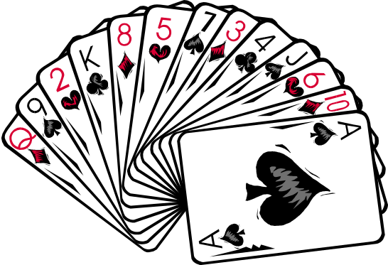
Selection-Sort
Selection-sort is the variation of PQ-sort where the priority queue is implemented with an unsorted sequence
Running time of Selection-sort:
  Inserting the elements into the priority queue with n insertItem operations takes O(n) time
  Removing the elements in sorted order from the priority queue with n removeMin operations takes time proportional to
  1 + 2 + …+ n
Selection-sort runs in O(n²) time
4
5
2
3
1

Slide 103

Insertion-Sort
Insertion-sort is the variation of PQ-sort where the priority queue is implemented with a sorted sequence
Running time of Insertion-sort:
  Inserting the elements into the priority queue with n insertItem operations takes time proportional to
  1 + 2 + …+ n
  Removing the elements in sorted order from the priority queue with a series of n removeMin operations takes O(n) time
Insertion-sort runs in O(n²) time
1
2
3
4
5

Slide 104

What is a heap (§2.4.3)
A heap is a binary tree storing keys at its internal nodes and satisfying the following properties:
  Heap-Order: for every internal node v other than the root,
  key(v) ≥ key(parent(v))
  Complete Binary Tree: let h be the height of the heap
    for i = 0, … , h − 1, there are 2^{i} nodes of depth i
    at depth h − 1, the internal nodes are to the left of the external nodes
The last node of a heap is the rightmost internal node of depth h − 1
2
5
6
9
7
last node

Slide 105

Height of a Heap (§2.4.3)
Theorem: A heap storing n keys has height O(log n)
Proof: (we apply the complete binary tree property)
  Let h be the height of a heap storing n keys
  Since there are 2^{i} keys at depth i = 0, … , h − 2 and at least one key at depth h − 1, we have n ≥ 1 + 2 + 4 + … + 2^{h−2} + 1
  Thus, n ≥ 2^{h−1} , i.e., h ≤ log n + 1
depth
keys
0
1
1
2
h−2
2^{h−2}
h−1
1

Slide 106
Heaps and Priority Queues
We can use a heap to implement a priority queue
We store a (key, element) item at each internal node
We keep track of the position of the last node
For simplicity, we show only the keys in the pictures
(2, Sue)
(5, Pat)
(6, Mark)
(9, Jeff)
(7, Anna)

Slide 107

Insertion into a Heap (§2.4.3)
Method insertItem of the priority queue ADT corresponds to the insertion of a key k to the heap
The insertion algorithm consists of three steps
  Find the insertion node z (the new last node)
  Store k at z and expand z into an internal node
  Restore the heap-order property (discussed next)
2
5
z
6
9
7
insertion node
2
5
6
z
9
7
1

Slide 108
Upheap
After the insertion of a new key k, the heap-order property may be violated
Algorithm upheap restores the heap-order property by swapping k along an upward path from the insertion node
Upheap terminates when the key k reaches the root or a node whose parent has a key smaller than or equal to k
Since a heap has height O(log n), upheap runs in O(log n) time
2
1
5
1
5
2
z
z
9
7
6
9
7
6

Slide 109
Removal from a Heap (§2.4.3)
Method removeMin of the priority queue ADT corresponds to the removal of the root key from the heap
The removal algorithm consists of three steps
  Replace the root key with the key of the last node w
  Compress w and its children into a leaf
  Restore the heap-order property (discussed next)
2
5
6
w
9
7
last node
7
5
w
6
9

Slide 110
Downheap
After replacing the root key with the key k of the last node, the heap-order property may be violated
Algorithm downheap restores the heap-order property by swapping key k along a downward path from the root
Upheap terminates when key k reaches a leaf or a node whose children have keys greater than or equal to k
Since a heap has height O(log n), downheap runs in O(log n) time
7
5
5
w
6
7
w
6
9
9

Slide 111
Updating the Last Node
The insertion node can be found by traversing a path of O(log n) nodes
  Go up until a left child or the root is reached
  If a left child is reached, go to the right child
  Go down left until a leaf is reached
Similar algorithm for updating the last node after a removal

Slide 112

Heap-Sort (§2.4.4)
Consider a priority queue with n items implemented by means of a heap
  the space used is O(n)
  methods insertItem and removeMin take O(log n) time
  methods size, isEmpty, minKey, and minElement take time O(1) time
Using a heap-based priority queue, we can sort a sequence of n elements in O(n log n) time
The resulting algorithm is called heap-sort
Heap-sort is much faster than quadratic sorting algorithms, such as insertion-sort and selection-sort

Slide 113
Vector-based Heap Implementation (§2.4.3)
We can represent a heap with n keys by means of a vector of length n + 1
For the node at rank i
  the left child is at rank 2i
  the right child is at rank 2i + 1
Links between nodes are not explicitly stored
The leaves are not represented
The cell of at rank 0 is not used
Operation insertItem corresponds to inserting at rank n + 1
Operation removeMin corresponds to removing at rank n
Yields in-place heap-sort
2
5
6
9
7
2
5
6
9
7
0
1
2
3
4
5

Slide 114
Merging Two Heaps
We are given two two heaps and a key k
We create a new heap with the root node storing k and with the two heaps as subtrees
We perform downheap to restore the heap-order property
3
2
8
5
4
6
7
3
2
8
5
4
6
2
3
4
8
5
7
6

Slide 115

Bottom-up Heap Construction (§2.4.3)
We can construct a heap storing n given keys in using a bottom-up construction with log n phases
In phase i, pairs of heaps with 2^{i} −1 keys are merged into heaps with 2^{i+1}−1 keys
2^{i} −1
2^{i} −1
2^{i+1}−1

Slide 116
Example
16
15
4
12
6
7
23
20
25
5
11
27
16
15
4
12
6
7
23
20

Slide 117
Example (contd.)
25
5
11
27
16
15
4
12
6
9
23
20
15
4
6
23
16
25
5
12
11
9
27
20

Slide 118
Example (contd.)
7
8
15
4
6
23
16
25
5
12
11
9
27
20
4
6
15
5
8
23
16
25
7
12
11
9
27
20

Slide 119
Example (end)
10
4
6
15
5
8
23
16
25
7
12
11
9
27
20
4
5
6
15
7
8
23
16
25
10
12
11
9
27
20

Slide 120

Analysis
We visualize the worst-case time of a downheap with a proxy path that goes first right and then repeatedly goes left until the bottom of the heap (this path may differ from the actual downheap path)
Since each node is traversed by at most two proxy paths, the total number of nodes of the proxy paths is O(n)
Thus, bottom-up heap construction runs in O(n) time
Bottom-up heap construction is faster than n successive insertions and speeds up the first phase of heap-sort

Slide 121
Dictionaries
<
6
2
>
9
1
4
=
8

Slide 122
Outline and Reading
Dictionary ADT (§2.5.1)
Log file (§2.5.1)
Binary search (§3.1.1)
Lookup table (§3.1.1)
Binary search tree (§3.1.2)
  Search (§3.1.3)
  Insertion (§3.1.4)
  Deletion (§3.1.5)
  Performance (§3.1.6)

Slide 123
Dictionary ADT
The dictionary ADT models a searchable collection of key-element items
The main operations of a dictionary are searching, inserting, and deleting items
Multiple items with the same key are allowed
Applications:
  address book
  credit card authorization
  mapping host names (e.g., cs16.net) to internet addresses (e.g., 128.148.34.101)
Dictionary ADT methods:
  findElement(k): if the dictionary has an item with key k, returns its element, else, returns the special element NO_SUCH_KEY
  insertItem(k, o): inserts item (k, o) into the dictionary
  removeElement(k): if the dictionary has an item with key k, removes it from the dictionary and returns its element, else returns the special element NO_SUCH_KEY
  size(), isEmpty()
  keys(), Elements()

Slide 124
Log File
A log file is a dictionary implemented by means of an unsorted sequence
  We store the items of the dictionary in a sequence (based on a doubly-linked lists or a circular array), in arbitrary order
Performance:
  insertItem takes O(1) time since we can insert the new item at the beginning or at the end of the sequence
  findElement and removeElement take O(n) time since in the worst case (the item is not found) we traverse the entire sequence to look for an item with the given key
The log file is effective only for dictionaries of small size or for dictionaries on which insertions are the most common operations, while searches and removals are rarely performed (e.g., historical record of logins to a workstation)

Slide 125
Binary Search
Binary search performs operation findElement(k) on a dictionary implemented by means of an array-based sequence, sorted by key
  similar to the high-low game
  at each step, the number of candidate items is halved
  terminates after a logarithmic number of steps
Example: findElement(7)
0
1
3
4
5
7
8
9
11
14
16
18
19
l
m
h
0
1
3
4
5
7
8
9
11
14
16
18
19
l
m
h
0
1
3
4
5
7
8
9
11
14
16
18
19
l
m
h
0
1
3
4
5
7
8
9
11
14
16
18
19
l=m =h

Slide 126
Lookup Table
A lookup table is a dictionary implemented by means of a sorted sequence
  We store the items of the dictionary in an array-based sequence, sorted by key
  We use an external comparator for the keys
Performance:
  findElement takes O(log n) time, using binary search
  insertItem takes O(n) time since in the worst case we have to shift n/2 items to make room for the new item
  removeElement take O(n) time since in the worst case we have to shift n/2 items to compact the items after the removal
The lookup table is effective only for dictionaries of small size or for dictionaries on which searches are the most common operations, while insertions and removals are rarely performed (e.g., credit card authorizations)

Slide 127
Binary Search Tree
A binary search tree is a binary tree storing keys (or key-element pairs) at its internal nodes and satisfying the following property:
  Let u, v, and w be three nodes such that u is in the left subtree of v and w is in the right subtree of v. We have
  key(u) ≤ key(v) ≤ key(w)
External nodes do not store items
An inorder traversal of a binary search trees visits the keys in increasing order
6
2
9
1
4
8

Slide 128
Search
To search for a key k, we trace a downward path starting at the root
The next node visited depends on the outcome of the comparison of k with the key of the current node
If we reach a leaf, the key is not found and we return NO_SUCH_KEY
Example: findElement(4)
Algorithm findElement(k, v)
if T.isExternal (v)
  return NO_SUCH_KEY
  if k < key(v)
  return findElement(k, T.leftChild(v))
  else if k = key(v)
  return element(v)
  else { k > key(v) }
  return findElement(k, T.rightChild(v))
<
6
2
>
9
1
4
=
8

Slide 129
Insertion
<
6
To perform operation insertItem(k, o), we search for key k
Assume k is not already in the tree, and let let w be the leaf reached by the search
We insert k at node w and expand w into an internal node
Example: insert 5
2
>
9
1
4
>
8
w
6
2
9
1
4
8
w
5

Slide 130
Deletion
To perform operation removeElement(k), we search for key k
Assume key k is in the tree, and let let v be the node storing k
If node v has a leaf child w, we remove v and w from the tree with operation removeAboveExternal(w)
Example: remove 4
<
6
2
>
9
1
4
v
8
w
5
6
2
9
1
5
8

Slide 131
Deletion (cont.)
1
v
We consider the case where the key k to be removed is stored at a node v whose children are both internal
  we find the internal node w that follows v in an inorder traversal
  we copy key(w) into node v
  we remove node w and its left child z (which must be a leaf) by means of operation removeAboveExternal(z)
Example: remove 3
3
2
8
6
9
w
5
z
1
v
5
2
8
6
9

Slide 132
Performance
Consider a dictionary with n items implemented by means of a binary search tree of height h
  the space used is O(n)
  methods findElement , insertItem and removeElement take O(h) time
The height h is O(n) in the worst case and O(log n) in the best case

Slide 133
Dictionaries and Hash Tables
0
∅
1
025-612-0001
2
981-101-0002
3
∅
4
451-229-0004

Slide 134

Dictionary ADT (§2.5.1)
The dictionary ADT models a searchable collection of key-element items
The main operations of a dictionary are searching, inserting, and deleting items
Multiple items with the same key are allowed
Applications:
  address book
  credit card authorization
  mapping host names (e.g., cs16.net) to internet addresses (e.g., 128.148.34.101)
Dictionary ADT methods:
  findElement(k): if the dictionary has an item with key k, returns its element, else, returns the special element NO_SUCH_KEY
  insertItem(k, o): inserts item (k, o) into the dictionary
  removeElement(k): if the dictionary has an item with key k, removes it from the dictionary and returns its element, else returns the special element NO_SUCH_KEY
  size(), isEmpty()
  keys(), Elements()

Slide 135

Log File (§2.5.1)
A log file is a dictionary implemented by means of an unsorted sequence
  We store the items of the dictionary in a sequence (based on a doubly-linked lists or a circular array), in arbitrary order
Performance:
  insertItem takes O(1) time since we can insert the new item at the beginning or at the end of the sequence
  findElement and removeElement take O(n) time since in the worst case (the item is not found) we traverse the entire sequence to look for an item with the given key
The log file is effective only for dictionaries of small size or for dictionaries on which insertions are the most common operations, while searches and removals are rarely performed (e.g., historical record of logins to a workstation)

Slide 136

Hash Functions and Hash Tables (§2.5.2)
A hash function h maps keys of a given type to integers in a fixed interval [0, N − 1]
Example:
h(x) = x mod N
is a hash function for integer keys
The integer h(x) is called the hash value of key x
A hash table for a given key type consists of
  Hash function h
  Array (called table) of size N
When implementing a dictionary with a hash table, the goal is to store item (k, o) at index i = h(k)

Slide 137
Example
We design a hash table for a dictionary storing items (SSN, Name), where SSN (social security number) is a nine-digit positive integer
Our hash table uses an array of size N = 10,000 and the hash function
h(x) = last four digits of x
0
∅
1
025-612-0001
2
981-101-0002
3
∅
4
451-229-0004
…
9997
∅
9998
200-751-9998
9999
∅

Slide 138

Hash Functions (§ 2.5.3)
A hash function is usually specified as the composition of two functions:
Hash code map:
h₁: keys → integers
Compression map:
h₂: integers → [0, N − 1]
The hash code map is applied first, and the compression map is applied next on the result, i.e.,
h(x) = h₂(h₁(x))
The goal of the hash function is to “disperse” the keys in an apparently random way

Slide 139

Hash Code Maps (§2.5.3)
Memory address:
  We reinterpret the memory address of the key object as an integer (default hash code of all Java objects)
  Good in general, except for numeric and string keys
Integer cast:
  We reinterpret the bits of the key as an integer
  Suitable for keys of length less than or equal to the number of bits of the integer type (e.g., byte, short, int and float in Java)
Component sum:
  We partition the bits of the key into components of fixed length (e.g., 16 or 32 bits) and we sum the components (ignoring overflows)
  Suitable for numeric keys of fixed length greater than or equal to the number of bits of the integer type (e.g., long and double in Java)

Slide 140
Hash Code Maps (cont.)
Polynomial accumulation:
  We partition the bits of the key into a sequence of components of fixed length (e.g., 8, 16 or 32 bits)
  a₀ a₁ … a_{n−1}
  We evaluate the polynomial
  p(z) = a₀ + a₁ z + a₂ z² + …
  … + a_{n−1}z^{n−1}
  at a fixed value z, ignoring overflows
  Especially suitable for strings (e.g., the choice z = 33 gives at most 6 collisions on a set of 50,000 English words)
Polynomial p(z) can be evaluated in O(n) time using Horner’s rule:
  The following polynomials are successively computed, each from the previous one in O(1) time
  p₀(z) = a_{n−1}
  p_{i} (z) = a_{n−i−1} + zp_{i−1}(z)
  (i = 1, 2, …, n −1)
We have p(z) = p_{n−1}(z)

Slide 141

Compression Maps (§2.5.4)
Division:
  h₂ (y) = y mod N
  The size N of the hash table is usually chosen to be a prime
  The reason has to do with number theory and is beyond the scope of this course
Multiply, Add and Divide (MAD):
  h₂ (y) = (ay + b) mod N
  a and b are nonnegative integers such that
  a mod N ≠ 0
  Otherwise, every integer would map to the same value b

Slide 142

Collision Handling (§ 2.5.5)
Collisions occur when different elements are mapped to the same cell
Chaining: let each cell in the table point to a linked list of elements that map there
0
∅
1
025-612-0001
2
∅
3
∅
4
451-229-0004
981-101-0004
Chaining is simple, but requires additional memory outside the table

Slide 143

Linear Probing (§2.5.5)
Open addressing: the colliding item is placed in a different cell of the table
Linear probing handles collisions by placing the colliding item in the next (circularly) available table cell
Each table cell inspected is referred to as a “probe”
Colliding items lump together, causing future collisions to cause a longer sequence of probes
Example:
  h(x) = x mod 13
  Insert keys 18, 41, 22, 44, 59, 32, 31, 73, in this order
0
1
2
3
4
5
6
7
8
9
10
11
12
41
18
44
59
32
22
31
73
0
1
2
3
4
5
6
7
8
9
10
11
12

Slide 144

Search with Linear Probing
Consider a hash table A that uses linear probing
findElement(k)
  We start at cell h(k)
  We probe consecutive locations until one of the following occurs
    An item with key k is found, or
    An empty cell is found, or
    N cells have been unsuccessfully probed
Algorithm findElement(k)
i ← h(k)
p ← 0
repeat
c ← A[i]
if c = ∅
return NO_SUCH_KEY
else if c.key () = k
return c.element()
else
i ← (i + 1) mod N
  p ← p + 1
  until p = N
return NO_SUCH_KEY

Slide 145
Updates with Linear Probing
To handle insertions and deletions, we introduce a special object, called AVAILABLE, which replaces deleted elements
removeElement(k)
  We search for an item with key k
  If such an item (k, o) is found, we replace it with the special item AVAILABLE and we return element o
  Else, we return NO_SUCH_KEY
insert Item(k, o)
  We throw an exception if the table is full
  We start at cell h(k)
  We probe consecutive cells until one of the following occurs
    A cell i is found that is either empty or stores AVAILABLE, or
    N cells have been unsuccessfully probed
  We store item (k, o) in cell i

Slide 146

Double Hashing
Double hashing uses a secondary hash function d(k) and handles collisions by placing an item in the first available cell of the series
(i + jd(k)) mod N
for j = 0, 1, … , N − 1
The secondary hash function d(k) cannot have zero values
The table size N must be a prime to allow probing of all the cells
Common choice of compression map for the secondary hash function: d₂(k) = q − k mod q
where
  q < N
  q is a prime
The possible values for d₂(k) are
1, 2, … , q

Slide 147
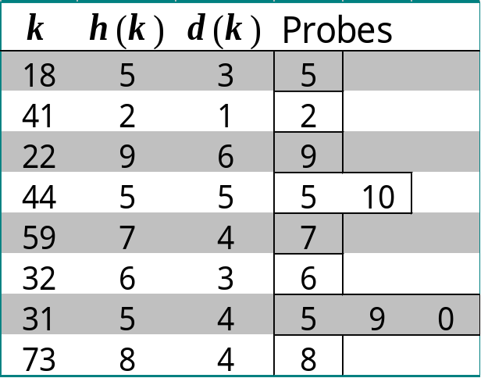
Example of Double Hashing
Consider a hash table storing integer keys that handles collision with double hashing
  N = 13
  h(k) = k mod 13
  d(k) = 7 − k mod 7
Insert keys 18, 41, 22, 44, 59, 32, 31, 73, in this order
0
1
2
3
4
5
6
7
8
9
10
11
12
31
41
18
32
59
73
22
44
0
1
2
3
4
5
6
7
8
9
10
11
12

Slide 148

Performance of Hashing
In the worst case, searches, insertions and removals on a hash table take O(n) time
The worst case occurs when all the keys inserted into the dictionary collide
The load factor α = n/N affects the performance of a hash table
Assuming that the hash values are like random numbers, it can be shown that the expected number of probes for an insertion with open addressing is
1 / (1 − α)
The expected running time of all the dictionary ADT operations in a hash table is O(1)
In practice, hashing is very fast provided the load factor is not close to 100%
Applications of hash tables:
  small databases
  compilers
  browser caches

Slide 149

Universal Hashing (§ 2.5.6)
A family of hash functions is universal if, for any 0<i,j<M-1, Pr(h(j)=h(k)) < 1/N.
Choose p as a prime between M and 2M.
Randomly select 0<a<p and 0<b<p, and define h(k)=(ak+b mod p) mod N
Theorem: The set of all functions, h, as defined here, is universal.

Slide 150
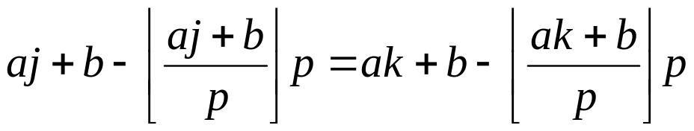
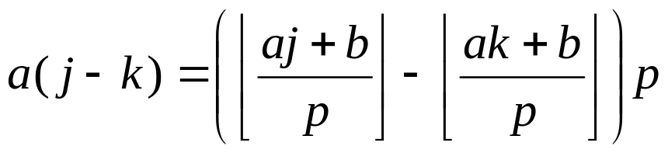
Proof of Universality (Part 1)
Let f(k) = ak+b mod p
Let g(k) = k mod N
So h(k) = g(f(k)).
f causes no collisions:
  Let f(k) = f(j).
  Suppose k<j. Then
So a(j-k) is a multiple of p
But both are less than p
So a(j-k) = 0. I.e., j=k. (contradiction)
Thus, f causes no collisions.

Slide 151

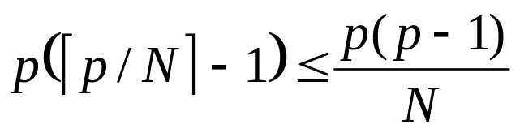
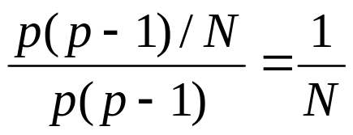
Proof of Universality (Part 2)
If f causes no collisions, only g can make h cause collisions.
Fix a number x. Of the p integers y=f(k), different from x, the number such that g(y)=g(x) is at most
Since there are p choices for x, the number of h’s that will cause a collision between j and k is at most
There are p(p-1) functions h. So probability of collision is at most
Therefore, the set of possible h functions is universal.

